Slide 1
Power BI dataflows Technical overview
Speaker Name
Title

Slide 2
Where we are: a quick review
Dataflows: Evolving Power BI
Dataflows are like Excel
It’s not only about Power BI

Slide 3







Reviewing Business Intelligence solutions
Self-Service BI
OLTP systems
Data Warehouse
Reports and dashboards
Data Lake
Data Preparation / ETL
OLAP / Analytics Models

Slide 4
Modern BI challenges
Fragmented, incomplete data
Pulling together data from traditional and cloud data sources, and figuring out how to enrich it is extremely difficult.
Requires a team of specialists
Creating E2E BI solutions requires multiple BI tools. This requires specific knowledge of each of the tools and complex integration to build and maintain an E2E BI solution.
Business data has no structural or semantic consistency
Different applications, departments, and analysts define data in different ways, which makes data exploration, and reuse of data and apps extremely challenging.
Complex system integration
Traditional BI solutions span multiple applications and services. Sharing data across systems requires each system to understand the location, structure and meaning of the data.
Notes:
As customer strive to take advantage of the digital transformation that is occurring in virtually every industry, they need to re-evaluate how they engage with their customers/prospects, how they transform their products and operations, and how they empower and understand their employees.
In today’s world, doing each of these things is more and more reliant upon data…traditionally, everything you knew about your customers and prospects was available in your business application systems and in the heads of employees. You learned almost everything about your products BEFORE they left your warehouse. Employees used technology more to enter data than to learn from it.
In the data-driven world we live in today, leveraging intelligent insights from data across customers, products, and employees is critical to be able to stay competitive and keep up with or lead digital transformation in any industry. And this isn’t just a customer’s typical business application data – it’s also about augmenting the customer’s data with additional data (e.g. search, employee behavioral data, sentiment data, benchmark data, etc..) – and applying the right intelligence to drive meaningful insights.
Let’s take a look at how this might help businesses(next slide – top of mind)
_______________________________
ORIGINAL TALKING POINTS:
The lower left-hand side customers. If you think about -- and this is sort of traditionally the domain of CRM, customer engagement. If you think about CRM traditionally, it was a system largely about the "known knowns." You know, you were in my CRM system if I knew your name, maybe had some contact information.
But, increasingly, our customers -- or even our prospects before they are customers -- are showing up to us in anonymous form first. They're a profile on the other side of a Web session, some random Twitter handle tweeting about my brand, and they're coming at me from all of these various channels that are digitally delivered. And that allows our customers, and in many ways mandates that our customers think differently about how they engage their customers. Collecting all of this information from these various sources, even prior to knowing who this individual is or being able to identify them, and being able to sort of take them on a journey intelligently based on these learnings. That's a fundamental change in the way that we're engaging our customers.
On the right-hand side at the bottom, products. I would argue this is the traditional ERP environment, where traditionally ERP was about collecting supply chain, manufacturing some products, warehousing them, shipping them out, hopefully getting paid. But once the product left the loading docks, hit the truck, it was gone.
Today, that is increasingly not the case. When I ship a product to a customer, that product is often connected back. It's sending lots of telemetry, and it's allowing me to rethink fundamentally the nature of the products and services. And it has huge implications for what's possible.
Think about manufacturing defects or quality, being able to assess your posture as a result of real data for real customer use.
Watching the use of consumables, doing a better job of planning inventory. Predicting when a piece of capital equipment is going to fail, and then proactively managing it, versus allowing the customer to get into a situation of dissatisfaction. Again, fundamental reimagination of what's possible on the product side.
And these two things are inextricably linked. And I'm learning something about my customers I never could if I can observe their use of my products and services, I can feed that right back into the customer engagement cycle. I can recommend new products and services.
So this sort of interconnected set of business processes is brand new, powered by data, artificial intelligence, and as we'll talk, delivered through Dynamics 365.
But this last loop is the people loop. When you think about the kinds of people that we need in our organization that can operate in this digitally transformed environment, the kind of tools that you need to allow them to create, collaborate, communicate, and to do that connected with the business processes that transformed, and to do it with data. Again, fundamental change I how we find these people, convince them to join our organization, provide them with tools that they need in order to connect with customers and connect with products. This opportunity is real, and it is what's driving all the growth.

Slide 5
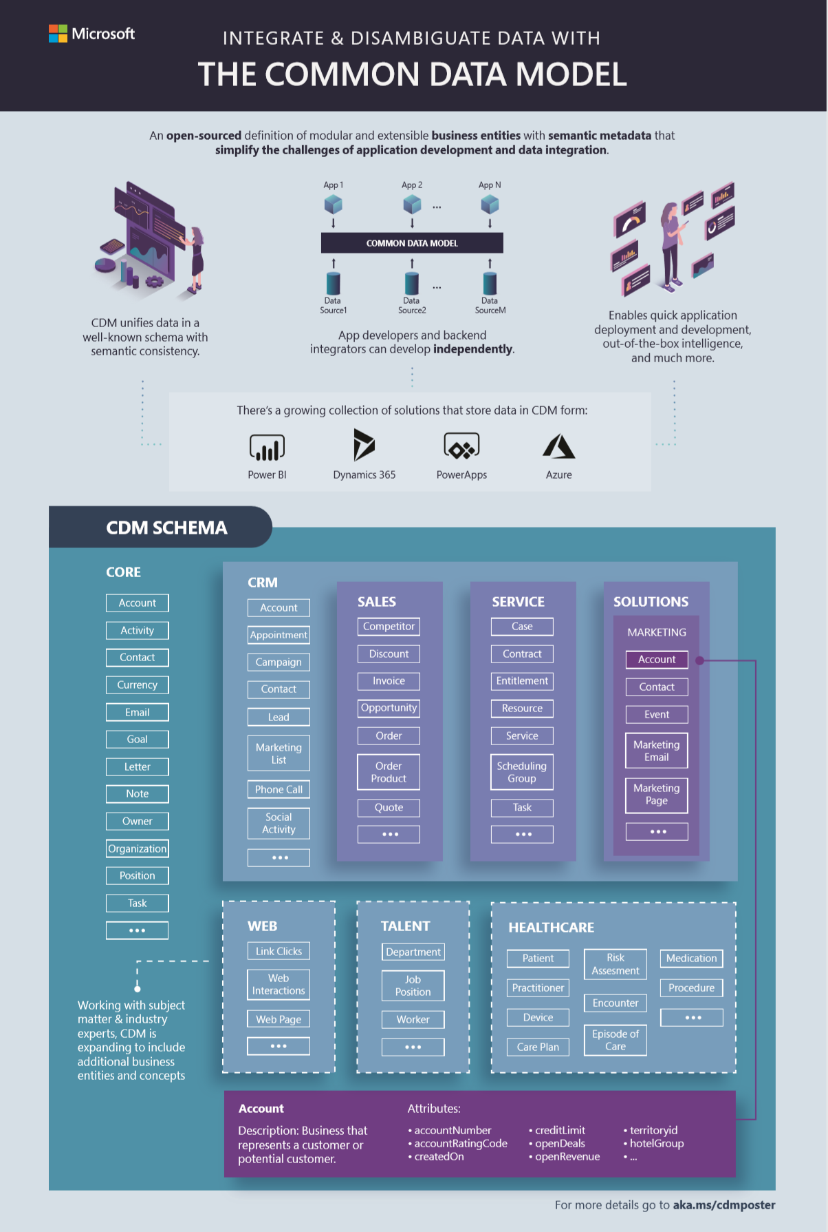
The Common Data Model (CDM) provides modular, and extensible business entities (Account, Lead, Opportunity, etc.) It unifies data in a well-known schema with semantic consistency across applications and deployments. ​ Customers, system integrators, and ISVs can develop turnkey business and intelligence applications, that share data based on these CDM entities. They can also extend entities to capture additional business-specific ideas.​ aka.ms/cdmposter
Common Data Model (CDM)

Slide 6
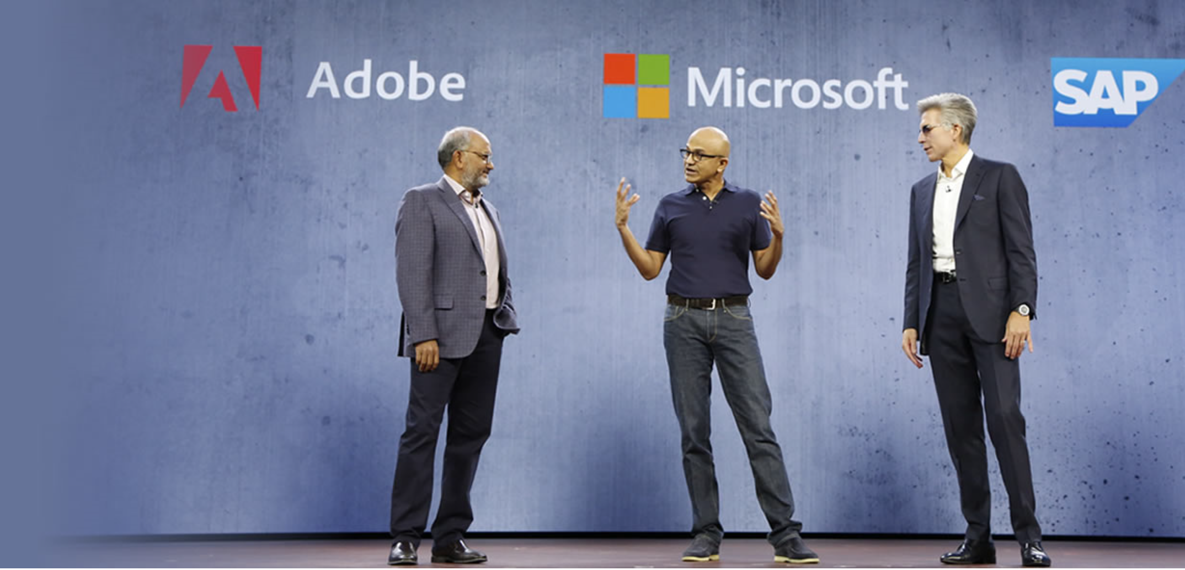
Announcing the
Open Data Initiative
Deliver unparalleled business insight from your behavioral, transactional, financial, and operational data with the Open Data Initiative—a jointly-developed vision by Adobe, Microsoft, and SAP.

Slide 7
Where we are: a quick review
Dataflows: Evolving Power BI
Dataflows are like Excel
It’s not only about Power BI

Slide 8
Self-service low code/no code
Integral part of Power BI stack
Cloud and on-premises connectors
Power BI introduces self-service data-prep capabilities
Standard schema
(Common Data Model)
Data reuse
In-lake transformations
Notes:
The Microsoft Common Data Model (CDM) provides well-defined, modular, and extensible business entities at the center of the CDS application and intelligence platforms.
Customers, system integrators, and ISVs can build on and depend on these standard CDM definitions, and also easily extend the models to capture additional business-specific ideas.
The Microsoft Common Data Model (CDM) provides a common data structure ISV’s, BI Pros and analysts can collaborate on.

Slide 9
Power BI introduces self-service data-prep capabilities
Self-service low code/no code
Integral part of Power BI stack
Cloud and on-premises connectors
Standard schema
(Common Data Model)
Dataflows
In-lake transformations
Data reuse
Notes:
How to get answers to business questions about your data?

Slide 10
Power BI introduces dataflows
Reports & dashboards Visualizations
Datasets
BI models
Dataflows
Data prep
Storage
Data (Azure Data Lake)
Gateways and connectors
Notes:
How to get answers to business questions about your data?

Slide 11

Modern BI challenges
Fragmented, incomplete data
Pulling together data from traditional and cloud data sources, and figuring out how to enrich it is extremely difficult.
Requires a team of specialists
Creating E2E BI solutions requires multiple BI tools. This requires specific knowledge of each of the tools and complex integration to build and maintain an E2E BI solution.
Business data has no structural or semantic consistency
Different applications, departments, and analysts define data in different ways, which makes data exploration, and reuse of data and apps extremely challenging.
Complex system integration
Traditional BI solutions span multiple applications and services. Sharing data across systems requires each system to understand the location, structure and meaning of the data.
Notes:
As customer strive to take advantage of the digital transformation that is occurring in virtually every industry, they need to re-evaluate how they engage with their customers/prospects, how they transform their products and operations, and how they empower and understand their employees.
In today’s world, doing each of these things is more and more reliant upon data…traditionally, everything you knew about your customers and prospects was available in your business application systems and in the heads of employees. You learned almost everything about your products BEFORE they left your warehouse. Employees used technology more to enter data than to learn from it.
In the data-driven world we live in today, leveraging intelligent insights from data across customers, products, and employees is critical to be able to stay competitive and keep up with or lead digital transformation in any industry. And this isn’t just a customer’s typical business application data – it’s also about augmenting the customer’s data with additional data (e.g. search, employee behavioral data, sentiment data, benchmark data, etc..) – and applying the right intelligence to drive meaningful insights.
Let’s take a look at how this might help businesses(next slide – top of mind)
_______________________________
ORIGINAL TALKING POINTS:
The lower left-hand side customers. If you think about -- and this is sort of traditionally the domain of CRM, customer engagement. If you think about CRM traditionally, it was a system largely about the "known knowns." You know, you were in my CRM system if I knew your name, maybe had some contact information.
But, increasingly, our customers -- or even our prospects before they are customers -- are showing up to us in anonymous form first. They're a profile on the other side of a Web session, some random Twitter handle tweeting about my brand, and they're coming at me from all of these various channels that are digitally delivered. And that allows our customers, and in many ways mandates that our customers think differently about how they engage their customers. Collecting all of this information from these various sources, even prior to knowing who this individual is or being able to identify them, and being able to sort of take them on a journey intelligently based on these learnings. That's a fundamental change in the way that we're engaging our customers.
On the right-hand side at the bottom, products. I would argue this is the traditional ERP environment, where traditionally ERP was about collecting supply chain, manufacturing some products, warehousing them, shipping them out, hopefully getting paid. But once the product left the loading docks, hit the truck, it was gone.
Today, that is increasingly not the case. When I ship a product to a customer, that product is often connected back. It's sending lots of telemetry, and it's allowing me to rethink fundamentally the nature of the products and services. And it has huge implications for what's possible.
Think about manufacturing defects or quality, being able to assess your posture as a result of real data for real customer use.
Watching the use of consumables, doing a better job of planning inventory. Predicting when a piece of capital equipment is going to fail, and then proactively managing it, versus allowing the customer to get into a situation of dissatisfaction. Again, fundamental reimagination of what's possible on the product side.
And these two things are inextricably linked. And I'm learning something about my customers I never could if I can observe their use of my products and services, I can feed that right back into the customer engagement cycle. I can recommend new products and services.
So this sort of interconnected set of business processes is brand new, powered by data, artificial intelligence, and as we'll talk, delivered through Dynamics 365.
But this last loop is the people loop. When you think about the kinds of people that we need in our organization that can operate in this digitally transformed environment, the kind of tools that you need to allow them to create, collaborate, communicate, and to do that connected with the business processes that transformed, and to do it with data. Again, fundamental change I how we find these people, convince them to join our organization, provide them with tools that they need in order to connect with customers and connect with products. This opportunity is real, and it is what's driving all the growth.

Slide 12

Dynamics 365 Apps
PowerApps
Power BI Apps
CDS for Apps
Power BI
Integration
Intelligence
ADLS v2
Enrichment and AI
Data Integration
Common Data Model

Slide 13
Where we are: a quick review
Dataflows: Evolving Power BI
Dataflows are like Excel
It’s not only about Power BI

Slide 14
Power BI Dataflows are like Excel
The difficult part of data preparation is usually not the individual job, package, or query – it is ensuring all of the jobs, packages, and queries run as a logical and reliable system
Each Dataflow Entity has a formula
The Power BI Dataflow calculation engine understands the relationships between all entities
Update one, the rest update automatically and consistently – just like Excel
Notes:
Bonus: Dataflows deliver authoritative data lineage

Slide 15
Power BI Dataflows are like Excel
Sources
20
Ingest from Dynamics Sales
22 entities
Clean and enrich sales data
10 entities
8
CRM – Production
Dynamics 365
10
Final Business View
11 entities
4
1
1
IoT Signal
Azure Data Lake Storage
Product Telemetry in Azure
5 entities
Add Telemetry Customer Attributes
6 entities
4
1
Azure Analysis Services
Sales/Telemetry Reference Data
Dataflow

Slide 16
Where we are: a quick review
Dataflows: Evolving Power BI
Dataflows are like Excel
It’s not only about Power BI

Slide 17
Power BI Recap
Reports & dashboards
Datasets
Dataflows
Storage
Notes:
Power BI users can now easily create dataflows to prepare data in a centralized storage, using a standardized schema, ready for easy consumption, reuse, and the generation of business insights. Data is stored in Azure Data Lake Store gen2, and is integrated with Power BI and Azure data services. Dataflows are available to Pro and Premium customers.

Slide 18
But what if…
Reports & dashboards
…we want to leverage the data created by the dataflow in applications or services outside of Power BI?
Datasets
Dataflows
Storage

Slide 19




Data + AI professionals can use the full power of the Azure Data Platform
Reports & dashboards
Azure Data Factory
Azure Databricks
Azure SQL DW
Azure ML
Datasets
Dataflows
Azure Data Lake Storage Gen2
CDM folder
CDM folder
CDM folder
Data scientists Data engineers
Low to high code
Business analysts
Low/no code

Slide 20
But what if…
Reports & dashboards
…we want to leverage the data created by the dataflow in applications or services outside of Power BI?
…or to provide an easy way to consume analytical data created outside of Power BI, in Power BI?
Datasets
Dataflows
Storage

Slide 21

Deliver ready-made insights to Power BI users from Azure
Self service customizations
in Power BI
Dynamics 365 for Finance & Operations
Azure Data Factory
Azure Databricks
Azure SQL DW
Azure ML
Dataflow
Dynamics 365 data
Azure Data Lake Storage Gen2
CDM folder
Notes:
Challenge: Provide customers with great ready-made insights in the product –and enable unconstrained self service customizations
Dyn365F&O offers best in class ready-made Analytics embedded within the product.
Provide customers with no-cliffs extensibility: Within minutes, Power BI customers should be able to extend solutions leveraging data, reports and dashboards from Dyn365F&O as well as other systems
Extensibility of existing solutions is possible at two levels
Build customization experiences within your application
Enable customization and personalization experiences within the product for users of the App
Data is still contained within the application, not visible to other applications and services
Mashing up with data from other applications and services is not possible
Make data available to applications that specialize in customizations
Leverage the power of rich, robust experiences that Power users and developers are familiar with
Allows integrating data from multiple sources including Web and IoT sensors
Customers may need to copy the data over multiple times or set up ETL infrastructure and storage to make it available
Operations and Finance + Power BI + Dataflows win, because companies can:
Quickly deploy Power BI template with customizable Reports, Dashboards with data in CDM format
Customize or enhance the templates with data from other apps or sources using Power Bi’s rich connectors
Deploy other solutions that depend on schematized data with common or custom data model without any ETL required

Slide 22




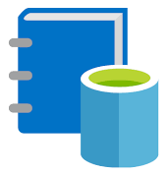
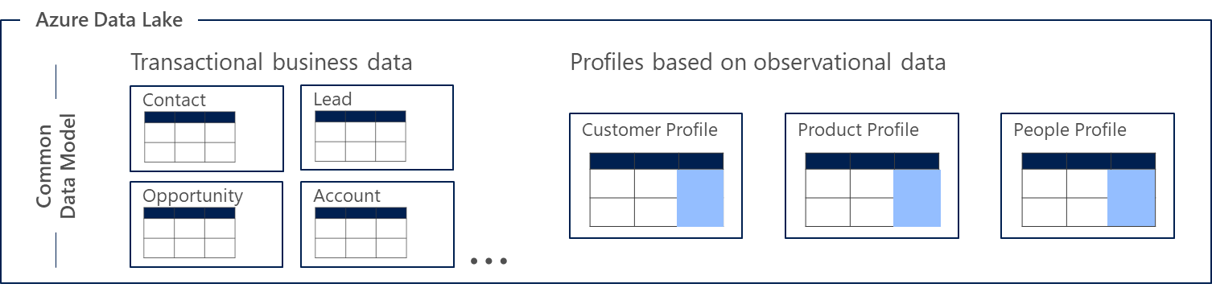
Enabling low friction collaboration among Data + AI professionals
Business analysts
Low/no code
Data scientists, Data engineers
Low to high code
Power BI
Dynamics 365
Azure IoT
Azure Data Services
data cataloging, data prep, AI, machine learning, data warehousing
ISV partners
Informatica,
etc.
Custom LOB + Developer resources
Power BI
dataflows
CDS for Apps data
Azure Data Lake Storage Gen2
CDM folders

Slide 23
Integrating CDM Folders with the Modern Data Warehouse
Azure Data Services
Azure Databricks
Azure Machine Learning
Azure Data Warehouse
Azure Data Factory
Azure Data Lake Storage Gen2
CDM folders

Slide 24
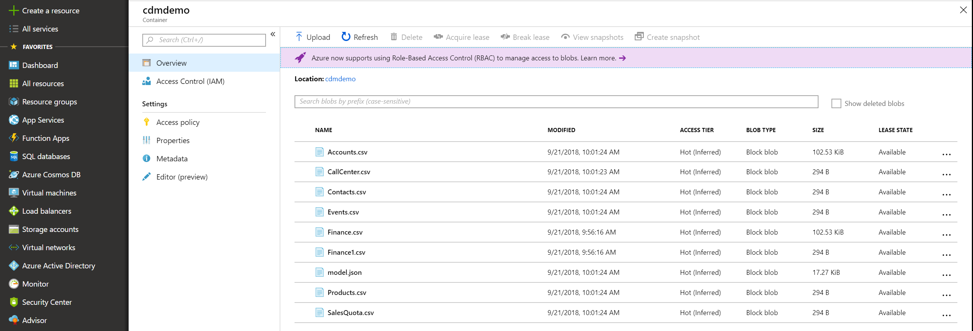
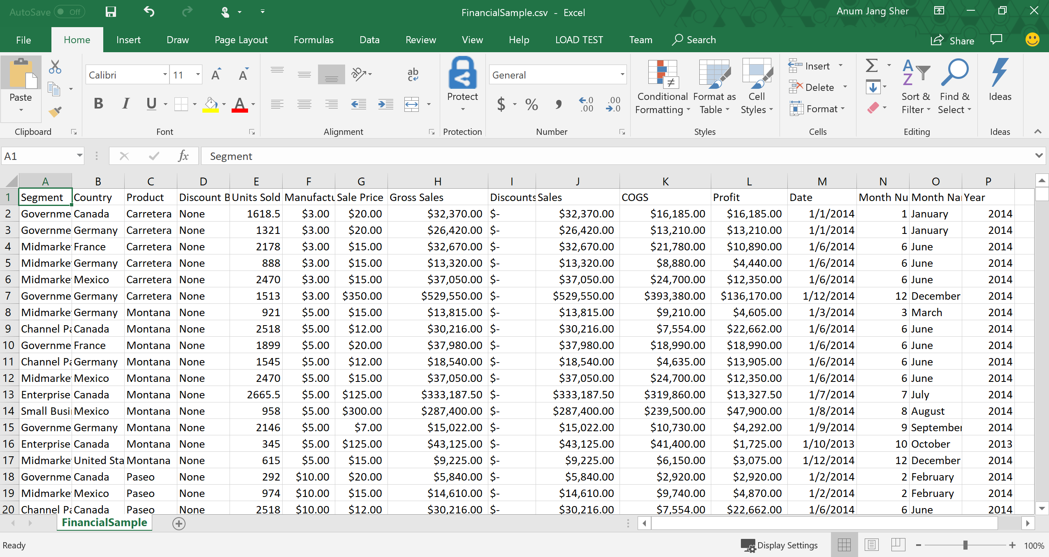
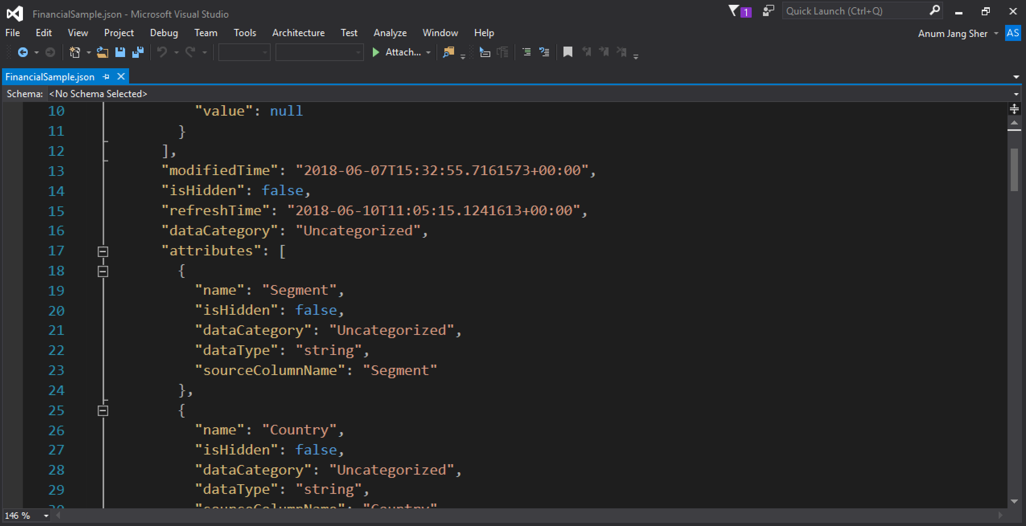
Integrating CDM Folders with the Modern Data Warehouse
salescdmfolder

Slide 25
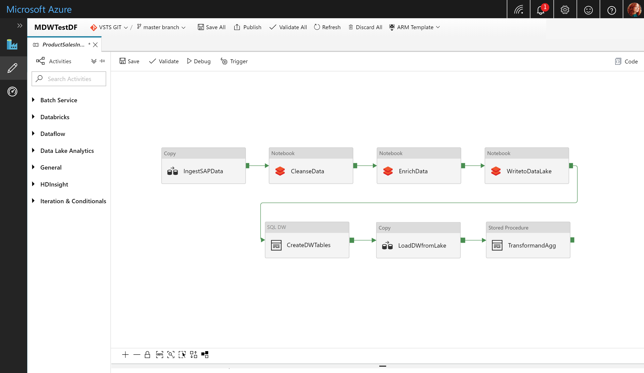
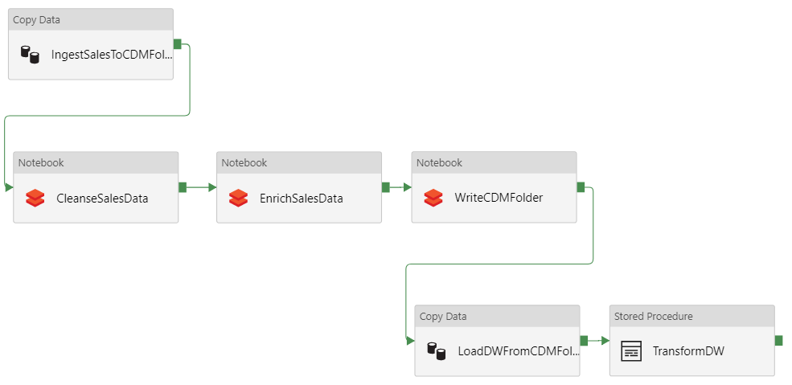
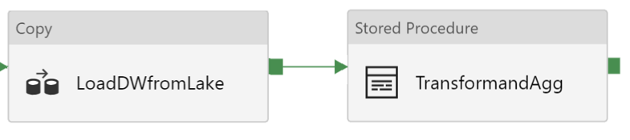
MDWSalesPipeline

Slide 26
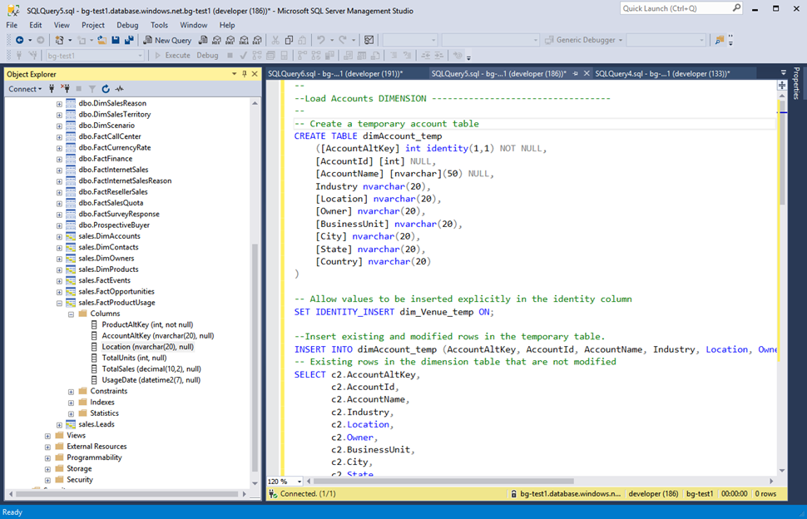

Slide 27
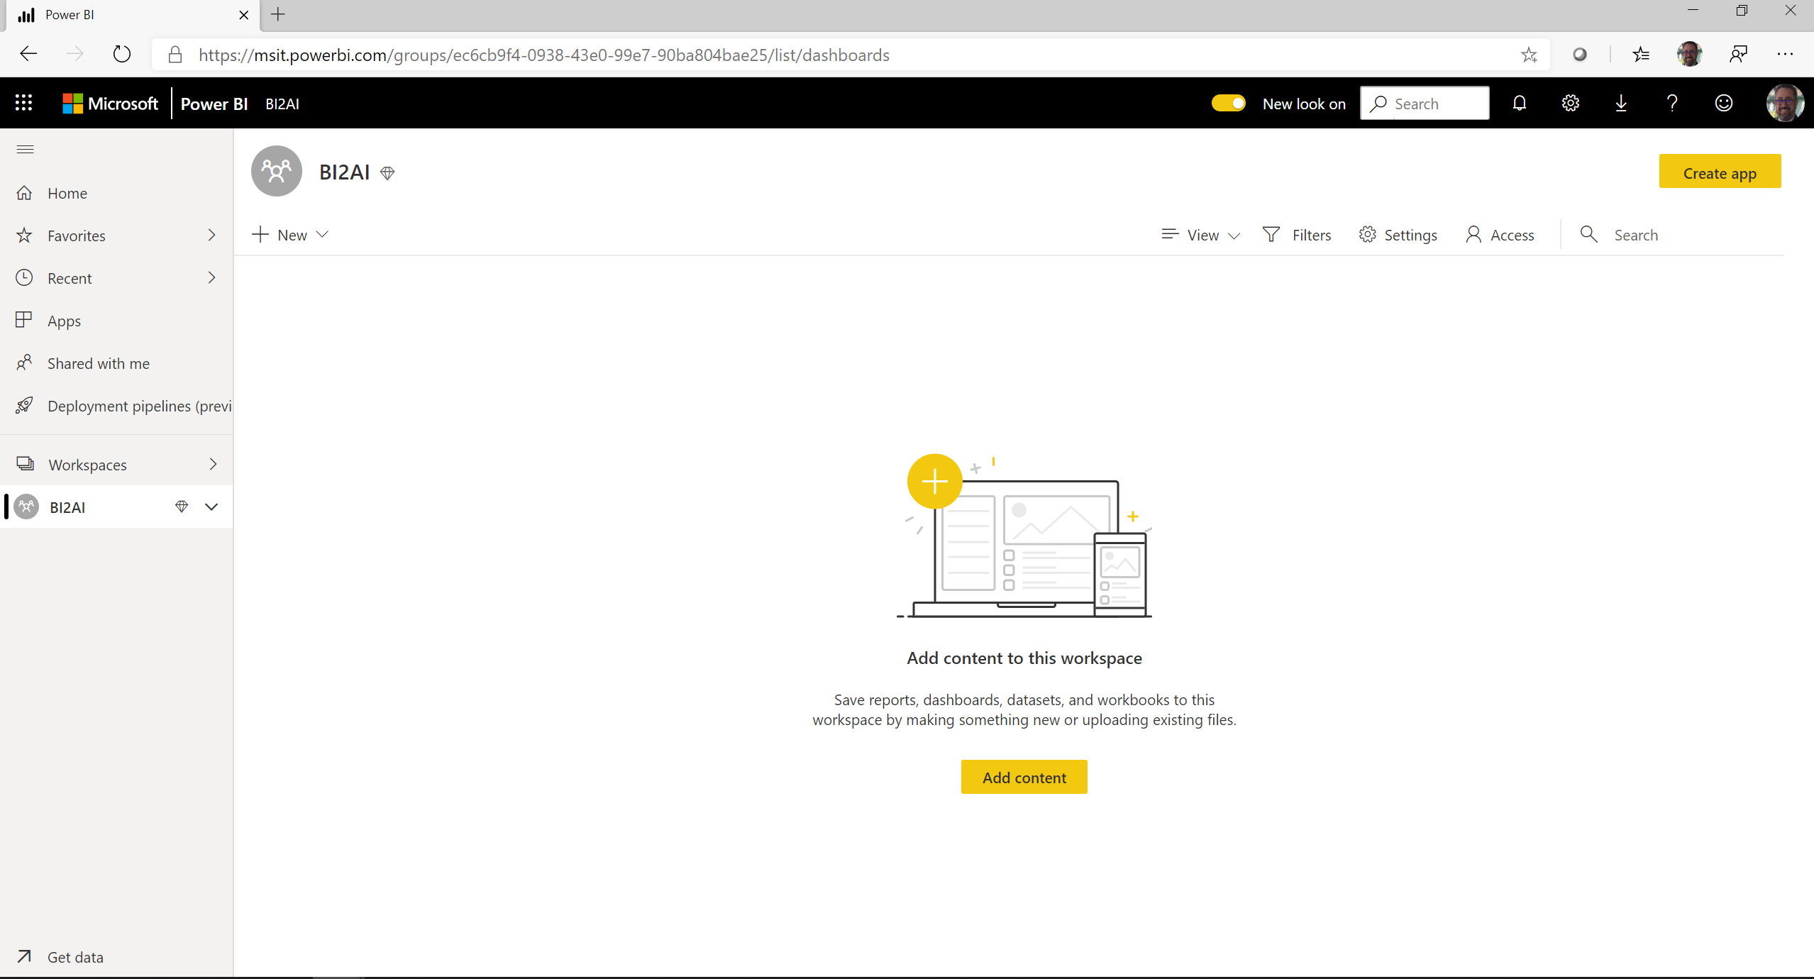

Slide 28
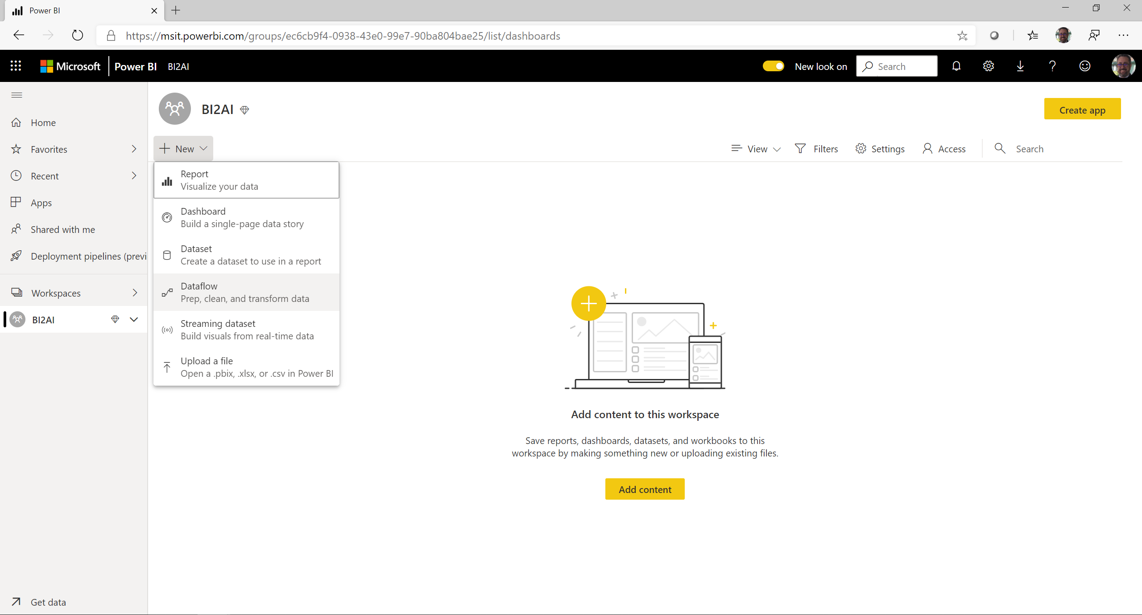

Slide 29
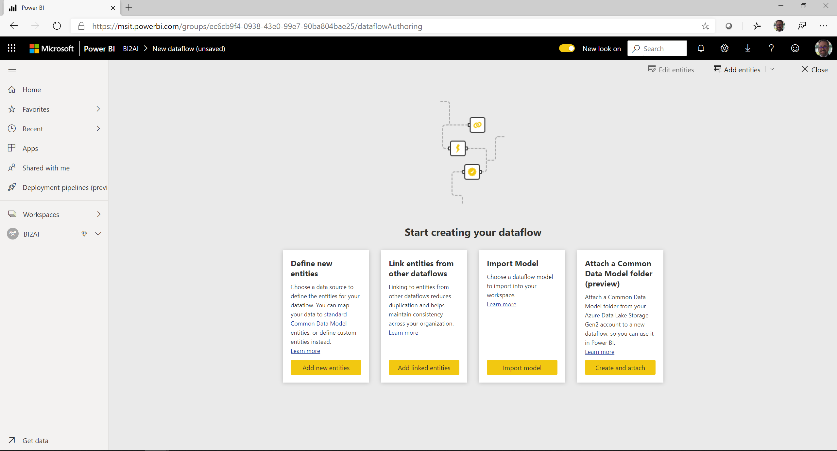

Slide 30
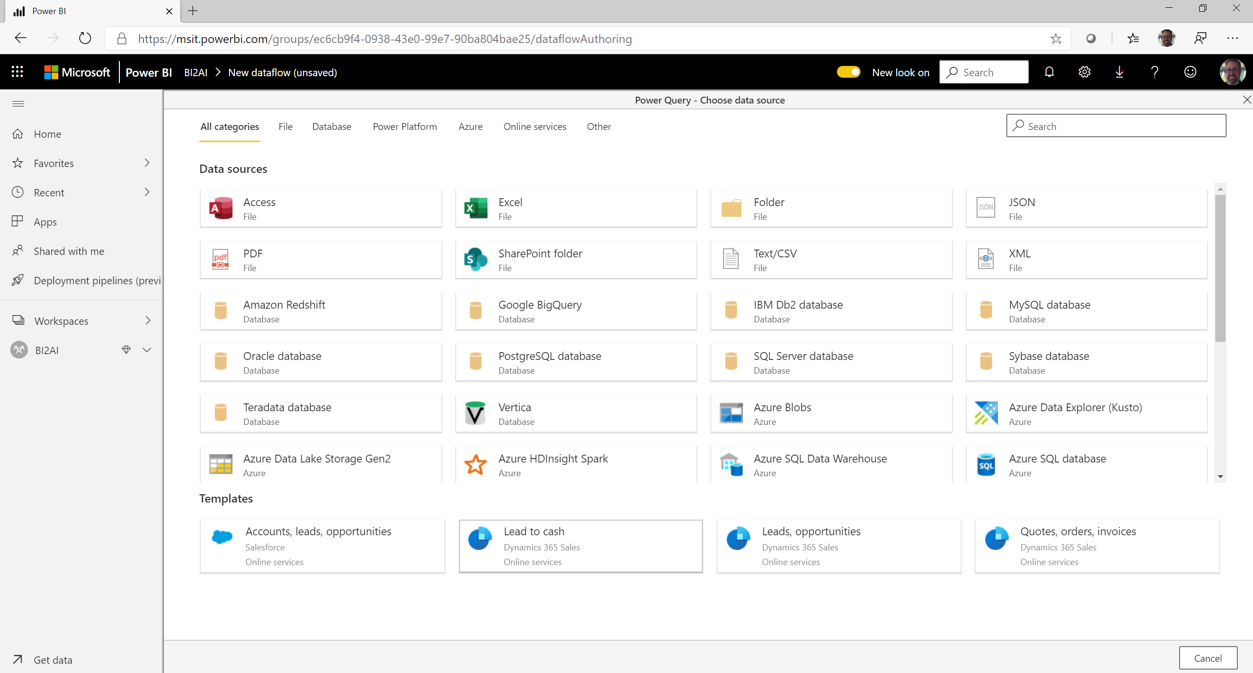

Slide 31
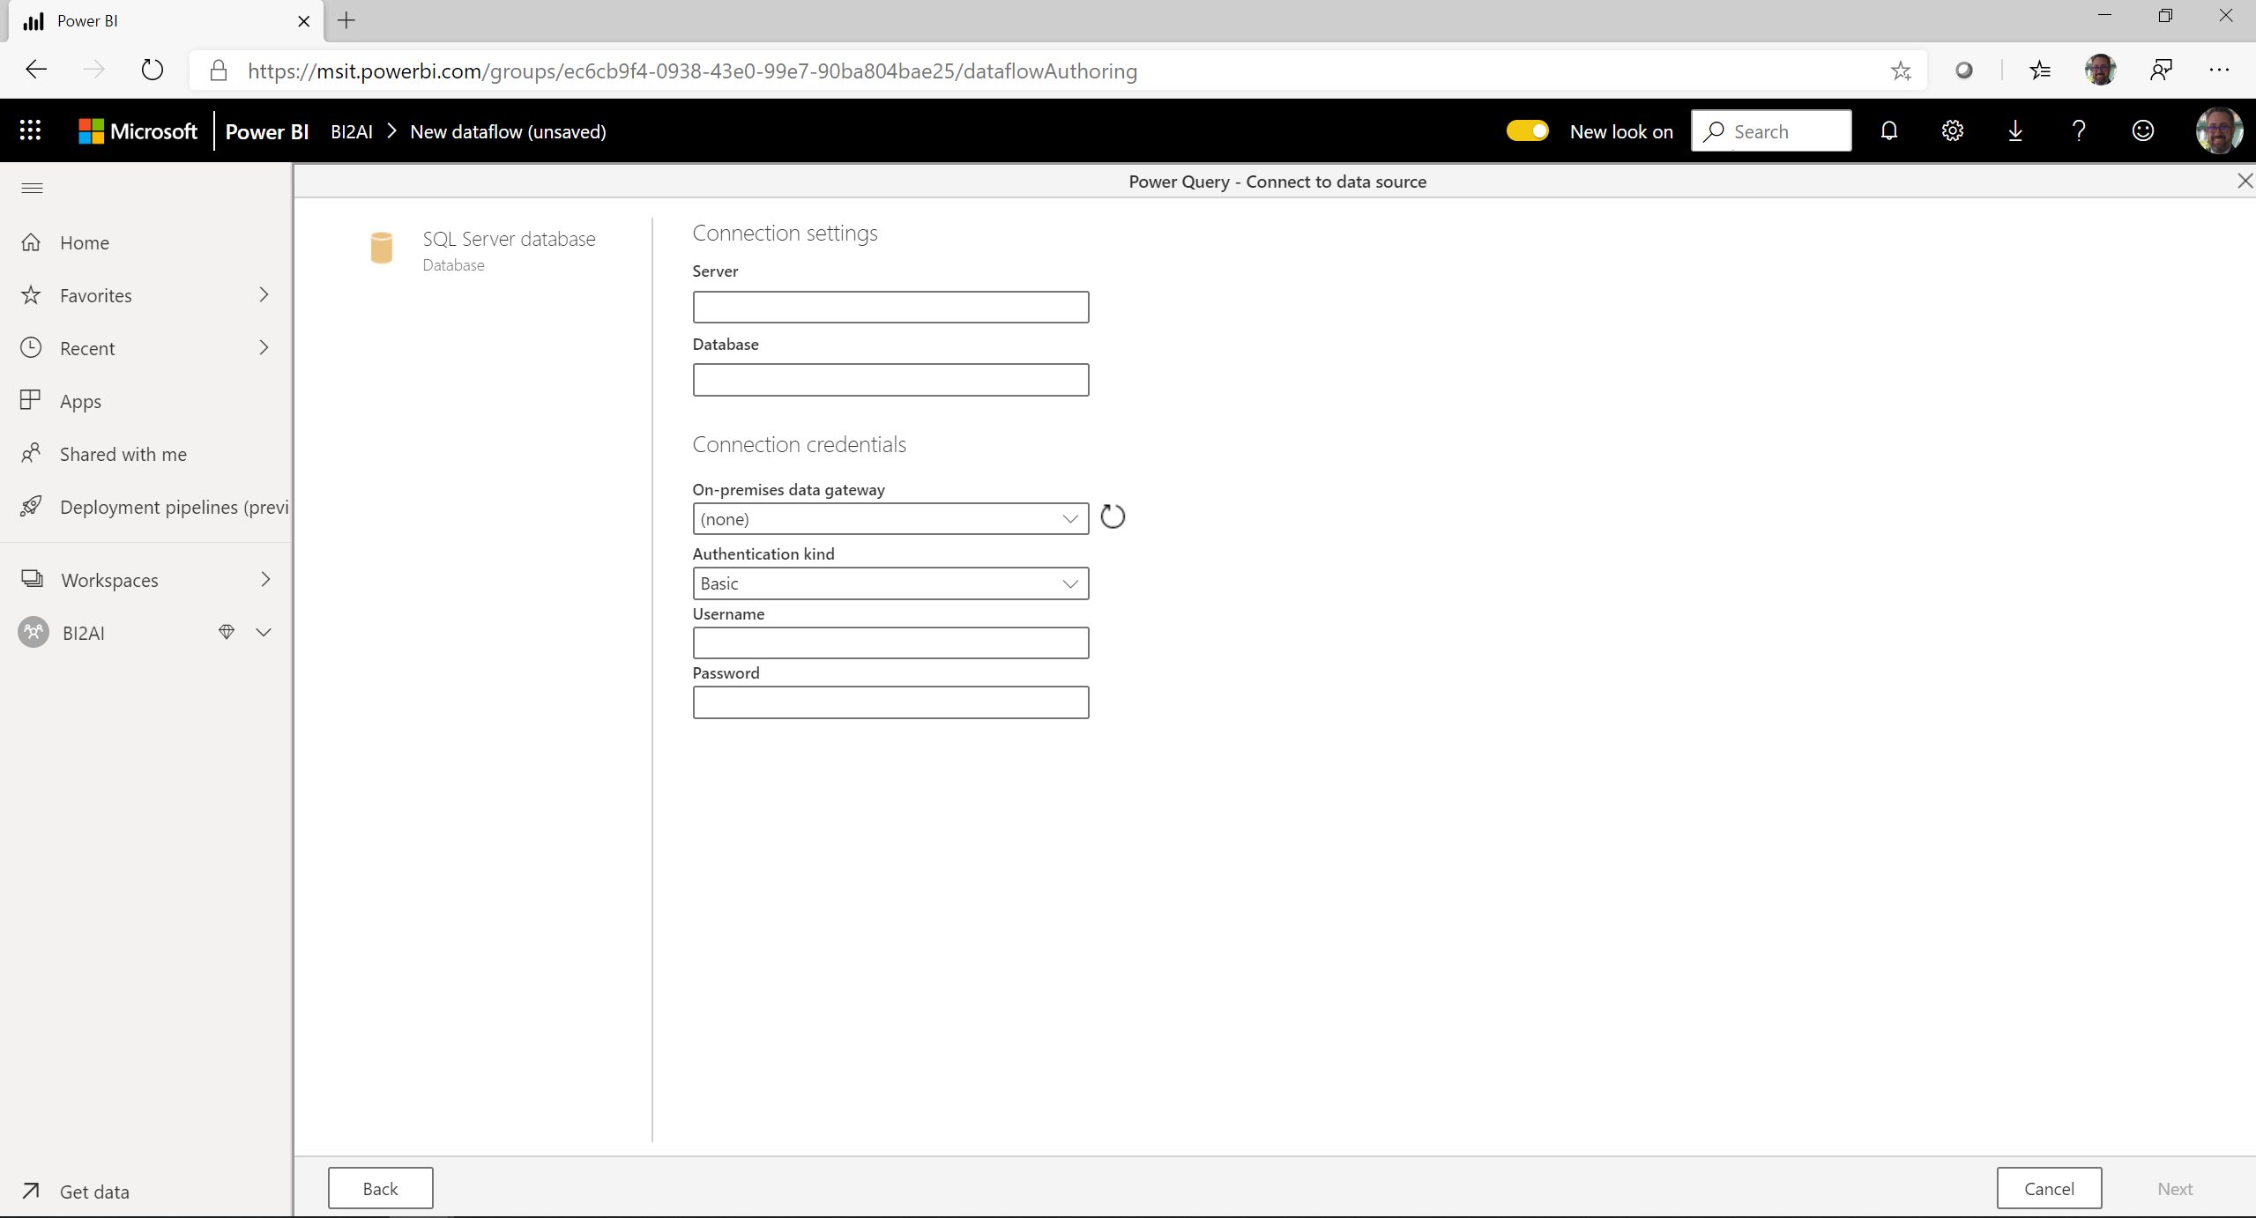

Slide 32
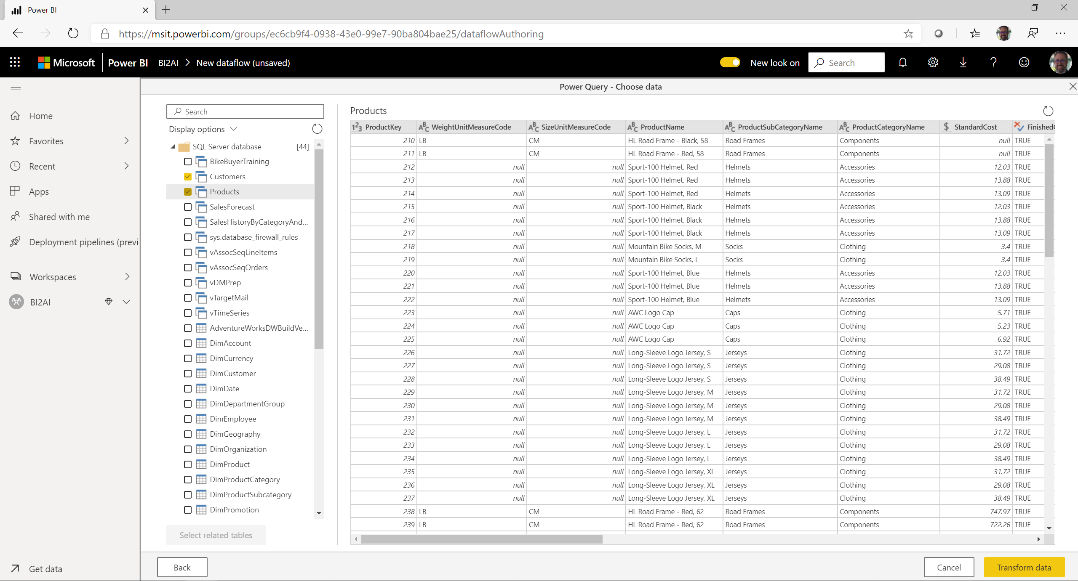

Slide 33
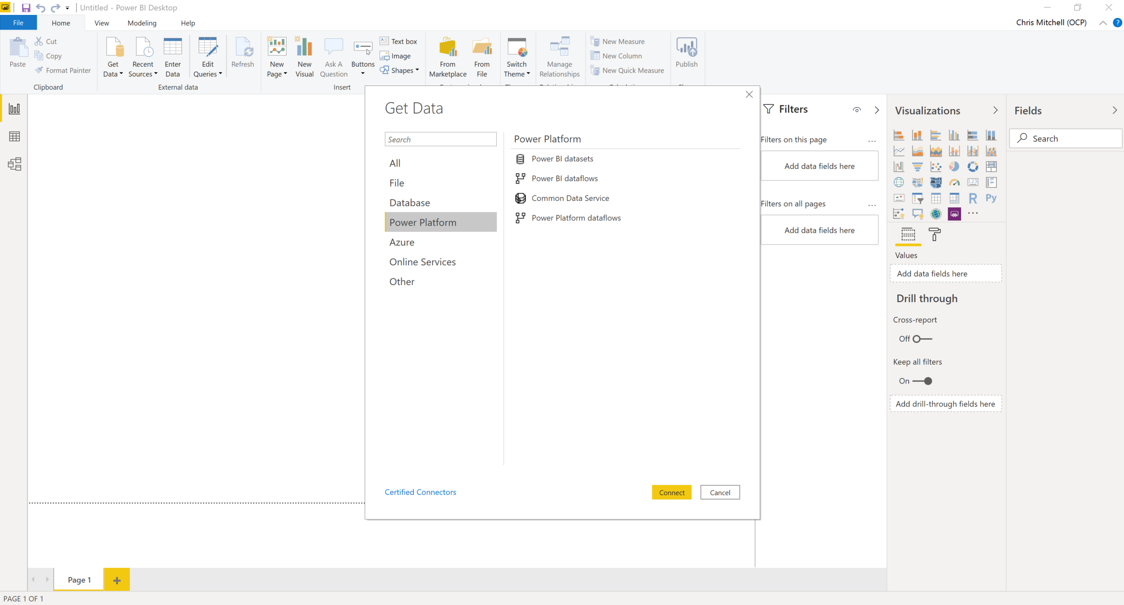

Slide 34
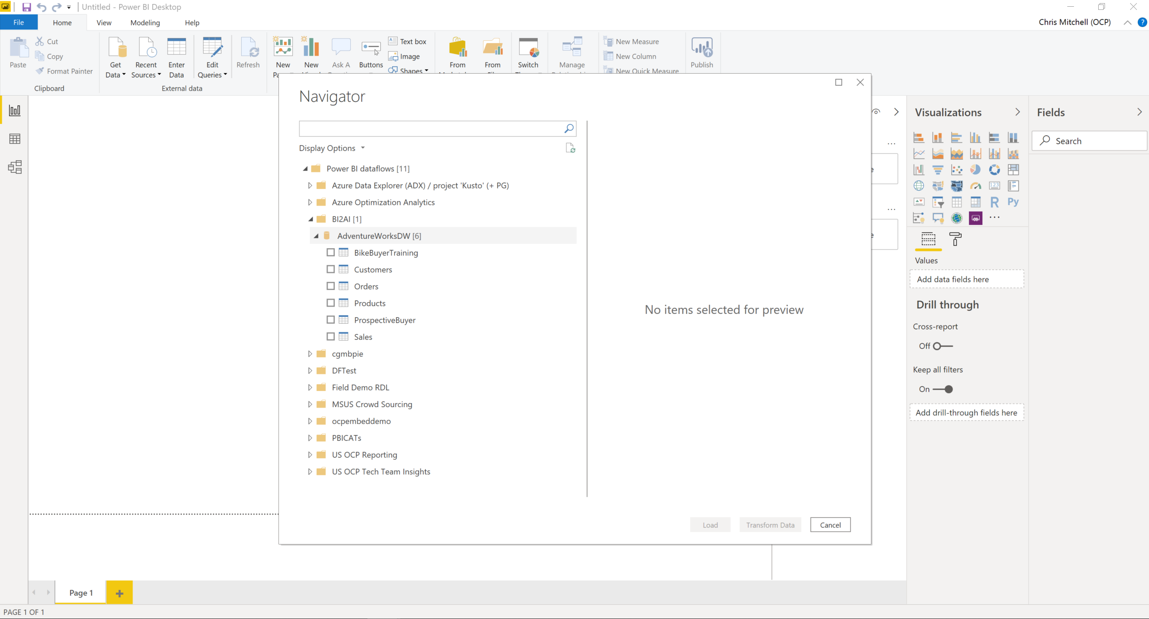

Slide 35
Resources
Power BI Documentation
https://docs.microsoft.com/en-us/power-bi/
Power BI Guided Learning
https://docs.microsoft.com/en-us/power-bi/guided-learning/
Power BI Webinars
https://docs.microsoft.com/en-us/power-bi/webinars
Power BI Whitepapers
https://docs.microsoft.com/en-us/power-bi/whitepapers
Power BI Blogs
https://powerbi.microsoft.com/en-us/blog/

Slide 36

It’s easy to get started…
PowerBI.com
Notes:
Key points
Go to Powerbi.com to get started.
Learn more about Power BI Premium from the Powerbi.com site
Internal to Microsoft. You can go to aka.ms/BI and access documentation and presentations both internal and customer facing.
TALK TRACK
If you want to learn more about Power BI Premium, simply go to the Power site to learn more.
Then, for internal users, the place to go for slide decks and content demos is aka.ms/BI.

